Slide 1
Siemens Financial Services Private Limited
Assistance in implementation of LOS, LMS system
This document is intended solely for the information and internal use of the recipient and contains confidential and proprietary information. It is not intended to be and should not be used by any other person or entity. This document or any parts thereof are meant for the use of only the intended recipient and should not be circulated, distributed or copied. Acies assumes no responsibility for any losses or damages suffered by the recipient or any third-party from the use of information in this document.
ACIES, Acies Consulting, Acies TechWorks, Acies Ventures, Acies LightHouse, Kepler, Kore, Callisto, Carpo, Revolutio and Antares are registered trademarks of Acies Consulting LLP and its subsidiaries in different countries and territories. Unauthorized use, misrepresentation or misuse of trademarks is strictly prohibited and subject to legal action under various laws.
By using this material and any information contained in it, you accept this entire notice and all terms & conditions specified herein.

Slide 2

Contents
1
About Acies and our value proposition
2
How we can help in the system implementation
3
Teaming model and governance structure
4
Select case studies and credentials
5
Proposed commercials

Slide 3
About Acies

Slide 4






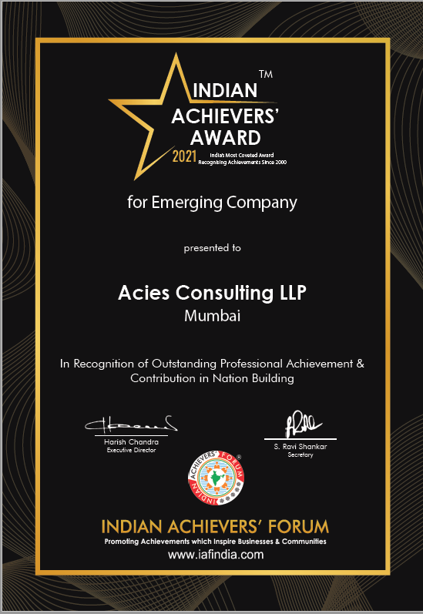
The Acies philosophy
Innovate
Implement
Skill
Scale
Awarded Risk Management Consultant of the Year for being an industry standard setter focused on providing end-to-end solutions that deliver competitive advantage through robust risk management
Recognized as Emerging Company of the Year 2021 by the Indian Achievers’ Forum for the achievements in the use of technology to solve business problems for financial service industry
Honored by Regulation Asia for pioneering project in regulatory data management and reporting for one of largest private bank in India

Slide 5
Software products that address practical, on-ground challenges
Antares
Kepler
Callisto
Kore
Holistic balance sheet mgmt. and monitoring
Integrated credit risk
and IFRS 9 platform
Non-financial risk mgmt. and assurance
Trade booking and performance mgmt.
Antares ALM
Asset liability mgmt.
Kepler IFRS9
End-to-end IFRS9 system
Callisto ORM
Operational risk mgmt.
Kore Derivatives
Interest rate risk hedging platform, incl. risk control
Antares FCP
FTP & profitability mgmt.
Kepler IFRS 16
Complete lease accounting
Callisto SOX
SOX & ICFR requirements
Kore IP
Investment portfolio performance attribution
Antares P&B
Planning & budgeting
Kepler MRM
Model risk management
Callisto FRM
Fraud case management
Antares ICAAP
Basel Pillar 2 requirements
Kepler EWS
Credit early warning system
Kore MR
Market risk mgmt., incl. Basel advanced approaches
Callisto CMS
Compliance management
Antares CM
Basel Standardized App.
Kepler ACR
Credit risk Advanced App.
Callisto IA
Audit planning & mgmt.
Applications built on Revolutio, our proprietary no-code platform
REVOLUTIO for no-code app development
REVOLUTIO BI for no-code analytics & MIS

Slide 6
Our geographical presence and clients served across regions
Our geographical presence
India
Singapore
Malaysia
UAE
Oman
KSA
Egypt
Kuwait
Mauritius
USA
covers Acies offices and client locations
Advisory and Consulting
Serving some of the world’s most esteemed financial institutions
3rd party system implementations
Implementation of Acies’ systems
J P Morgan
Credit Suisse
BNP Paribas
Citibank
DBS Singapore
ICICI Bank
Kotak Mahindra Bank
Yes Bank
IOB Singapore
UCO Singapore
Gulf Bank of Kuwait
National Bank of Kuwait
17+ Life insurance companies
Kotak Mahindra Bank
Axis Bank
SBM Bank India
Gulf Bank of Kuwait
VW Financial Services
Edelweiss FS
NPCI
Saudi Arabian Monetary Authority
2 Life insurance companies
Vedanta Resources
Nayara energy
Axis Finance
Toyota Financial Services
Capri Global
Cagamas Berhad Malaysia
Al Ahli Bank of Kuwait Group
Kotak Mahindra Bank
AU Small Finance Bank
Suryoday Small Finance Bank
Ujjivan Small Finance Bank
Utkarsh Small Finance Bank
10+ Life insurance companies

Slide 7
Our team’s experience in system implementations
Third party systems
Data mgmt. and migration
Experience of new age technologies
Real-time project management
Experience across implementation lifecycle
Select experience in selection and implementation of third party systems
Assistance in digital onboarding system implementation, including providing functional advisory, project management, testing support and on-going cloud management services
Implementation of the loan
management system, functional support for cred and accounting, project tracking and risk management through out the system implementation
Reviewed and enhanced the credit technology architecture and identified opportunities to enhance business across the value chain by technology
Infina Finance
VW Financial Services
Edelweiss FS
Assistance in treasury system implementation, functional support incl. model validation for derivative products, assist in user acceptance testing and on-going project management
Identification and implementation of enhancements in treasury system,
re-engineering treasury processes,
validation and testing for all functional logics, regulatory requirements, metadata, accounting & interfaces
Assisted in re-engineering technology, documenting business requirement documents and process improvements, vendor evaluation and system selection
SBM Bank India
Kotak Mahindra Bank
NPCI

Slide 8
Summarizing our value proposition for the Company
Acies brings the right blend of functional expertise and project mgmt. experience to help the Company deliver a time-bound, out-come focused automation program that meets business & regulatory requirements
Strong project mgmt. and third-party system implementation experience
Functional SMEs to support each area of the system implementation
Worked with 10+ institutions in project mgmt. of system implementations
Extensive NBFC experience, with strong familiarity with deal lifecycles, data structures, accounting and reporting
SMEs for each relevant area – requirement finalization, accounting, data migration strategy, migration testing, UAT etc.
Awareness of typical challenges faced & common remediation / workarounds
Expertise-led project mgmt. and quality assurance services
Prebuilt tools and accelerators to deliver a
Proprietary technology to
overcome system limitations
Ready-to-deploy templates and dashboards for tracking project progress, deviations and overdue activities
Repositories of test cases, covering business and control requirements
Acies’ proprietary plug-and-play tech for:
No-code analytics, reporting and BI
Complete Ind AS 109 & 116 automation
Regulatory reporting for ALM, capital adequacy, SOX etc.

Slide 9
How we can help in the system implementation

Slide 10
Our understanding of your requirements
Summary of key requirements
Project management office setup and ongoing management through project lifecycle
Business requirement documentation and review of the functional specification documentation
Data migration strategy design and data element level identification for migration
Assistance in UAT testing and functional resolution for seamless go-live
Setup and run the project management office for the implementation of the LOS/LMS system
Assist in understanding and gathering the requirements for all business users and documenting the business requirement documentation and UAT test case documentation
Review the functional specification documentation created by the system vendor and undertake the requirement traceability matrix mapping between the business requirement documentation and the functional specification document creation
Design of the data migration strategy, execution steps and success metrics for migration of data from source systems to the revised system implementation
Designing the testing strategy and assistance in execution of the UAT test cases

Slide 11
Lifecycle and activities undertaken for data migration
Source to target data migration lifecycle
Assess
Operationalize
Manage
Strategy and scope
Migration design
Extract and transform
Load
Test
Stabilize
Support
Migration strategy (Agile vs one-time)
Source system inventory and ETL strategy
Extraction logics
Load data in target D/B
Data testing strategy
Handholding support
Support post stabilization period
Cutover time period
Meta data definition (masters/ transaction tables)
Transform logics
Load data quality checks
Data test cases
Data issue validation and checking
SLA breach management
Historical data treatment
Data pipeline setup
Data load frequency
Data validation
Address data gaps/issues
Ongoing data audits
Testing methodology
Meta data model definition
Data governance
Data pre-extraction audit
Data testing and RCA
Data archival and backup management
Backup and archival plan
Migration tool identification
Data integrity checks
Erroneous data treatment
Transition planning
Extract and transform SLAs
Data quality checks
Resolution and remediation
Key outcomes
Data migration strategy document
Data migration design
Data extraction and transformation
Data load in target DB
Data testing and validation
Support and ongoing management

Slide 12
Key consideration points in data migration
Data migration strategy and planning
Identify the underlying strategy for data migration between a big bang one-time migration vs an agile approach where data migration is done on a schedule by data source or by legacy source system
Data profiling, meta data model definition and management
Identify the underlying data sources and data structures including, source data schema definition, data point definition, master data and transaction data tagging, data clean-up and erroneous/missing value management
Cutover date and historical data migration strategy
Identification of data elements such as customer transaction history which needs to be moved on a balance transfer basis in line with accounting, regulatory and business considerations.
Robust data quality and accuracy checks at the time of data extraction and data transformation
Data gathered from multiple sources needs to go through extensive data cleansing, reconciliation and quality checks before the data can be migrated. Disjointed pipelines or extractions and transformations may limit the ability to perform these checks in a comprehensive manner across all data sources
Data governance and backup/archival management
The data governance and data backup policy for legacy systems needs to be defined in line with the regulatory considerations. Legacy data storage mode and data profiles that need to be stored (i.e. transaction data, master data, balance data etc.) will also need to be determined.

Slide 13







Building a robust extraction and transformation layer for migration
Web layer of transaction systems
Data warehouse /data marts (e.g. Oracle, Microsoft SQL etc.)
1
2
3
Transaction processing syst. (App layer)
Data Mgmt. Studio
Computation Studio
Data quality metrics
Data ingestion – file upload, API, staging DB and streaming
Data Import / Export
Data quality reports
Application databases (golden source)
Pre-processing checks & validation
Mathematical and logical operators
DQ metric setups
stateless compute
Statistical functions
User-defined limits on metrics
Data cleansing, back-filling & editing
Interim golden sources
ML / NLP functions
Data catalogue
& metadata mgmt.
User-configurable alerts & notifications
Python script editor
Unstructured
data files
Extract and Transform
Revolutio BI provides end-to-end data mgmt., analytics & reporting within one single, no-code platform, eliminating need for separate tools and empowering the end-user to be in control of the data flow and transformations configured in Revolutio, while simultaneously reducing development & maintenance cost through the use of a single consistent, no-code technology for extraction and transformation
Reports and dashboards
Notes:
-----
Purpose of the standard is to anchor the overall framework and demonstrate to regulators and other stakeholders that the Bank is consistently applying a specified standard
Operating framework calling out the stakeholders and their roles in the to-be processes covering data producers, system owners, EDW & data-mart owners, data consumers etc. as well as the manner in which data ownership roles are defined and applied across the Bank
It is important that the data management program delivers periodic short and medium term outcomes to ensure that it continues to meet the requirements of data consumers across use-cases
Fractioning investments across use-cases is key to optimizing the overall cost of data delivery to data consumers
Linking data ownership responsibilities to formal KRAs for data owners, stewards and data quality managers is crucial to promote accountability
Ensuring high-availability of data to data consumers while maintaining safeguards for preserving data privacy and security is important
Ensuring a consistent internal message and incentivizing participation goes a long way towards promoting a data driven culture at the bank
Periodic self-evaluations targeted at strengthening the framework through modern technologies, use-cases and feedback from external stakeholders is important
-----
Harnessing data to deliver a dynamic and personalized customer experience is a powerful differentiator
Data should be able to provide timely, decision support triggers to management
Centralized control over information disseminated to external stakeholders (regulators, investors etc.) is important
Evaluating use-case specific ROI and optimizing the use-case’s cost of ownership is important to prioritize use-cases and analytical investments
----
Embracing a flexible and open technology architecture allows modern technologies to be harnessed for driving use-cases
Adopting a functionality-driven approach for down-stream applications that adhere to the principles of the technology architecture

Slide 14
Roles and responsibilities for Data migration
SNo | High level activity map | Responsible | Accountable | Inform | Consult
1 | Strategy and scope
1.1 | Migration strategy (Agile vs one-time)
1.2 | Cutover time period
1.3 | Historical data treatment
1.4 | Meta data model definition
1.5 | Backup and archival plan
1.6 | Transition planning
2 | Migration design
2.1 | Source system inventory and ETL strategy
2.2 | Meta data definition (masters/ transaction tables)
2.3 | Testing methodology
2.4 | Data governance
Notes:
-----
Purpose of the standard is to anchor the overall framework and demonstrate to regulators and other stakeholders that the Bank is consistently applying a specified standard
Operating framework calling out the stakeholders and their roles in the to-be processes covering data producers, system owners, EDW & data-mart owners, data consumers etc. as well as the manner in which data ownership roles are defined and applied across the Bank
It is important that the data management program delivers periodic short and medium term outcomes to ensure that it continues to meet the requirements of data consumers across use-cases
Fractioning investments across use-cases is key to optimizing the overall cost of data delivery to data consumers
Linking data ownership responsibilities to formal KRAs for data owners, stewards and data quality managers is crucial to promote accountability
Ensuring high-availability of data to data consumers while maintaining safeguards for preserving data privacy and security is important
Ensuring a consistent internal message and incentivizing participation goes a long way towards promoting a data driven culture at the bank
Periodic self-evaluations targeted at strengthening the framework through modern technologies, use-cases and feedback from external stakeholders is important
-----
Harnessing data to deliver a dynamic and personalized customer experience is a powerful differentiator
Data should be able to provide timely, decision support triggers to management
Centralized control over information disseminated to external stakeholders (regulators, investors etc.) is important
Evaluating use-case specific ROI and optimizing the use-case’s cost of ownership is important to prioritize use-cases and analytical investments
----
Embracing a flexible and open technology architecture allows modern technologies to be harnessed for driving use-cases
Adopting a functionality-driven approach for down-stream applications that adhere to the principles of the technology architecture

Slide 15
Roles and responsibilities for Data migration
SNo | High level activity map | Responsible | Accountable | Inform | Consult
2.5 | Migration tool identification
2.6 | Extract and transform SLAs
3 | Extract and transform
3.1 | Extraction logics
3.2 | Transform logics
3.3 | Data pipeline setup
3.4 | Data pre-extraction audit
3.5 | Data integrity checks
3.6 | Data quality checks
4 | Load
4.1 | Load data in target D/B
4.2 | Load data quality checks
Notes:
-----
Purpose of the standard is to anchor the overall framework and demonstrate to regulators and other stakeholders that the Bank is consistently applying a specified standard
Operating framework calling out the stakeholders and their roles in the to-be processes covering data producers, system owners, EDW & data-mart owners, data consumers etc. as well as the manner in which data ownership roles are defined and applied across the Bank
It is important that the data management program delivers periodic short and medium term outcomes to ensure that it continues to meet the requirements of data consumers across use-cases
Fractioning investments across use-cases is key to optimizing the overall cost of data delivery to data consumers
Linking data ownership responsibilities to formal KRAs for data owners, stewards and data quality managers is crucial to promote accountability
Ensuring high-availability of data to data consumers while maintaining safeguards for preserving data privacy and security is important
Ensuring a consistent internal message and incentivizing participation goes a long way towards promoting a data driven culture at the bank
Periodic self-evaluations targeted at strengthening the framework through modern technologies, use-cases and feedback from external stakeholders is important
-----
Harnessing data to deliver a dynamic and personalized customer experience is a powerful differentiator
Data should be able to provide timely, decision support triggers to management
Centralized control over information disseminated to external stakeholders (regulators, investors etc.) is important
Evaluating use-case specific ROI and optimizing the use-case’s cost of ownership is important to prioritize use-cases and analytical investments
----
Embracing a flexible and open technology architecture allows modern technologies to be harnessed for driving use-cases
Adopting a functionality-driven approach for down-stream applications that adhere to the principles of the technology architecture

Slide 16
Roles and responsibilities for Data migration
SNo | High level activity map | Responsible | Accountable | Inform | Consult
4.3 | Data load frequency
5 | Test
5.1 | Data testing strategy
5.2 | Data test cases
5.3 | Data validation
5.4 | Data testing and RCA
5.5 | Erroneous data treatment
5.6 | Resolution and remediation
6 | Stabilize
6.1 | Handholding support
6.2 | Data issue validation and checking
6.3 | Address data gaps/issues
Notes:
-----
Purpose of the standard is to anchor the overall framework and demonstrate to regulators and other stakeholders that the Bank is consistently applying a specified standard
Operating framework calling out the stakeholders and their roles in the to-be processes covering data producers, system owners, EDW & data-mart owners, data consumers etc. as well as the manner in which data ownership roles are defined and applied across the Bank
It is important that the data management program delivers periodic short and medium term outcomes to ensure that it continues to meet the requirements of data consumers across use-cases
Fractioning investments across use-cases is key to optimizing the overall cost of data delivery to data consumers
Linking data ownership responsibilities to formal KRAs for data owners, stewards and data quality managers is crucial to promote accountability
Ensuring high-availability of data to data consumers while maintaining safeguards for preserving data privacy and security is important
Ensuring a consistent internal message and incentivizing participation goes a long way towards promoting a data driven culture at the bank
Periodic self-evaluations targeted at strengthening the framework through modern technologies, use-cases and feedback from external stakeholders is important
-----
Harnessing data to deliver a dynamic and personalized customer experience is a powerful differentiator
Data should be able to provide timely, decision support triggers to management
Centralized control over information disseminated to external stakeholders (regulators, investors etc.) is important
Evaluating use-case specific ROI and optimizing the use-case’s cost of ownership is important to prioritize use-cases and analytical investments
----
Embracing a flexible and open technology architecture allows modern technologies to be harnessed for driving use-cases
Adopting a functionality-driven approach for down-stream applications that adhere to the principles of the technology architecture

Slide 17
Roles and responsibilities for Data migration
SNo | High level activity map | Responsible | Accountable | Inform | Consult
7 | Support
7.1 | Support post stabilization period
7.2 | SLA breach management
7.3 | Ongoing data audits
7.4 | Data archival and backup management
Notes:
-----
Purpose of the standard is to anchor the overall framework and demonstrate to regulators and other stakeholders that the Bank is consistently applying a specified standard
Operating framework calling out the stakeholders and their roles in the to-be processes covering data producers, system owners, EDW & data-mart owners, data consumers etc. as well as the manner in which data ownership roles are defined and applied across the Bank
It is important that the data management program delivers periodic short and medium term outcomes to ensure that it continues to meet the requirements of data consumers across use-cases
Fractioning investments across use-cases is key to optimizing the overall cost of data delivery to data consumers
Linking data ownership responsibilities to formal KRAs for data owners, stewards and data quality managers is crucial to promote accountability
Ensuring high-availability of data to data consumers while maintaining safeguards for preserving data privacy and security is important
Ensuring a consistent internal message and incentivizing participation goes a long way towards promoting a data driven culture at the bank
Periodic self-evaluations targeted at strengthening the framework through modern technologies, use-cases and feedback from external stakeholders is important
-----
Harnessing data to deliver a dynamic and personalized customer experience is a powerful differentiator
Data should be able to provide timely, decision support triggers to management
Centralized control over information disseminated to external stakeholders (regulators, investors etc.) is important
Evaluating use-case specific ROI and optimizing the use-case’s cost of ownership is important to prioritize use-cases and analytical investments
----
Embracing a flexible and open technology architecture allows modern technologies to be harnessed for driving use-cases
Adopting a functionality-driven approach for down-stream applications that adhere to the principles of the technology architecture

Slide 18




Our approach summary
Our cohesive multi-phased approach is designed to address all aspects necessary for a successful implementation as illustrated below. The proposed approach has been designed taking into consideration the scope requirements as detailed out in the earlier sections and our understanding of your requirements. The approach has been divided into 5 main workstreams. Workstream 1 which is the project management workstream will be undertaken through the lifecycle of the project. The below approach and detailed activities of this approach are explained in subsequent sections of this document.
II) Requirement
finalization
III) Data migration strategy and execution design
IV) System configuration – functional support
V) Testing and validation
Assistance in vendor SRS/ FSD document development
Data migration strategy design (elements, historical data requirements, source systems)
Clarification with vendor for any functional queries
Assistance in user acceptance testing
Review development of FSD, TSD and requirement traceability matrix
Identification of individual data elements for migration
System mapping with FSD for completeness
Data migration testing
Review user acceptance testing strategy and test case preparation
Maintenance strategy for legacy data not migrated
Provide vendor assistance for FSD queries/change request management
Assistance in alternate solutioning if any
I) Setup and ongoing project management & stakeholder communication

Slide 19
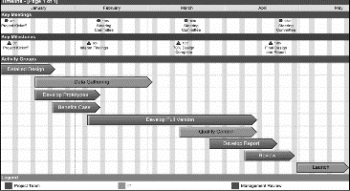
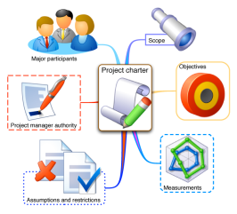
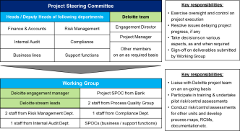
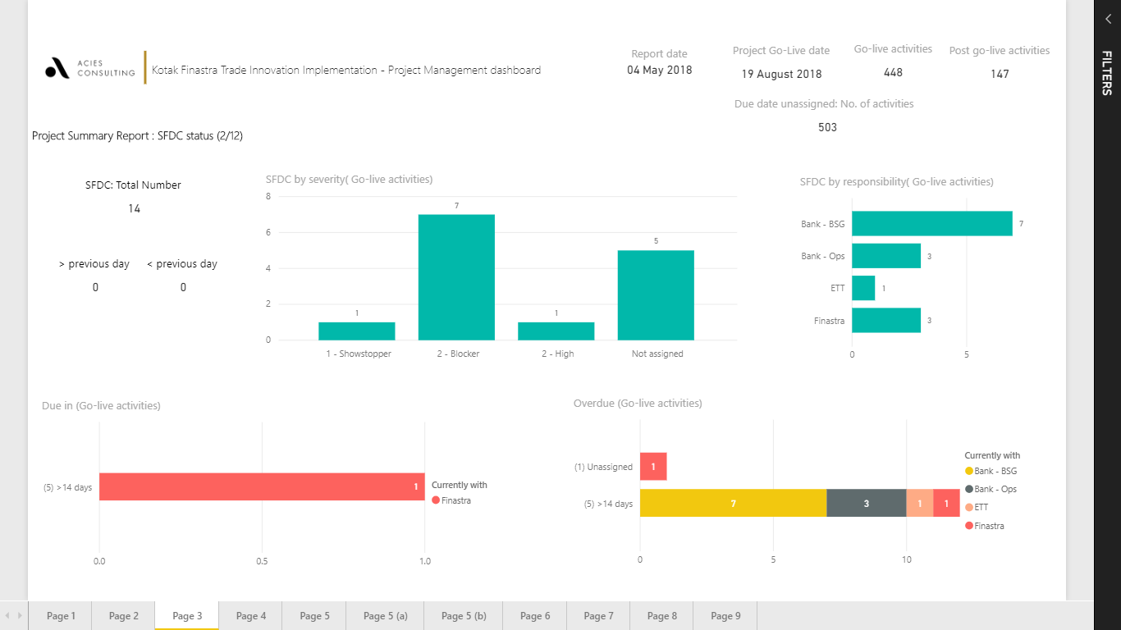
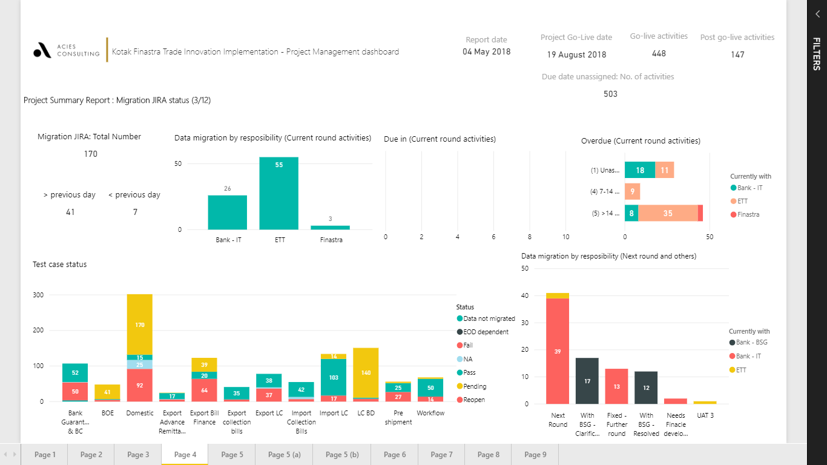
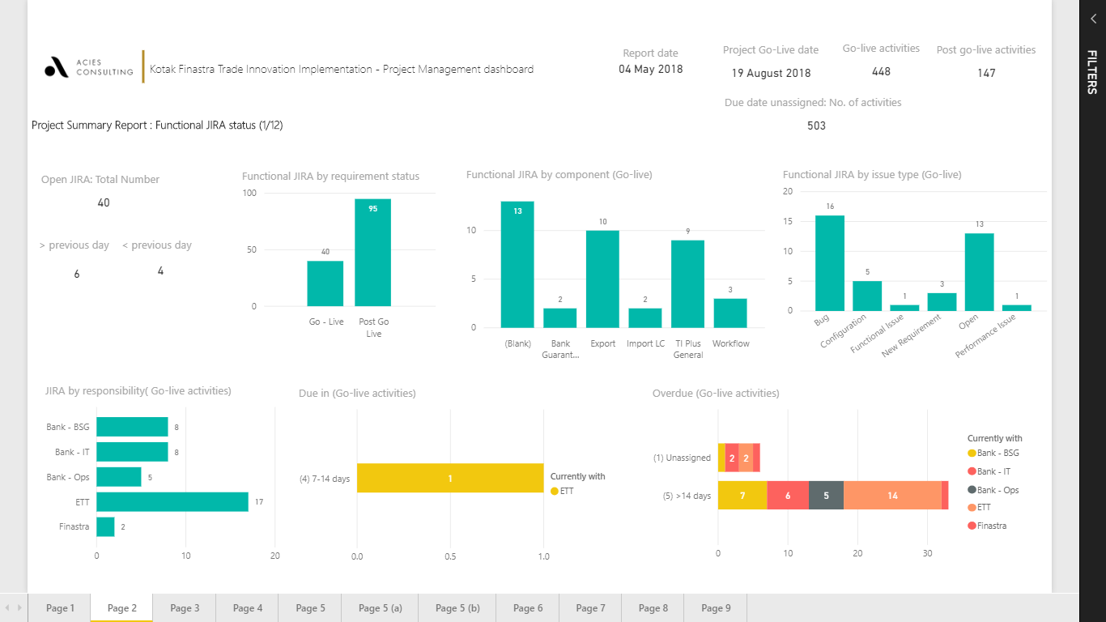
Our detailed approach
I
Setup and ongoing project management stakeholder communication
Objective
Setup of Project Management Office and Steering Committee & Working Group
Periodic status updates and on-going resolution of issues
Key activities to be undertaken
Outcomes from this phase
Set up a Project Management Office (‘PMO’) for the implementation of LOS/LMS system and provide updates to Steering Committee on an ongoing basis
Constitute Steering Committee and Working Group for the LOS/LMS system implementation, comprising senior management of the Company, process owners, Acies representatives and system vendor
Create milestone framework & metrics to evaluate project on an ongoing basis and rate milestones based on criticality and map potential risks
Monitor progress and address bottlenecks in the implementation process and escalate challenges to the Steering Committee
Facilitate the approval of workarounds where certain requirements cannot be natively met by vendor configurations
Project charter, specifying Committees and Members
Real-time, project management dashboard
Familiarity with system implementations
Cloud based, online project monitoring
Experience of
new-age technologies
Outcome oriented approach for PMO
Differentiators leveraged to expedite project delivery

Slide 20
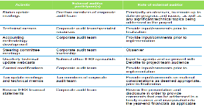
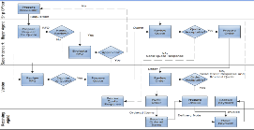
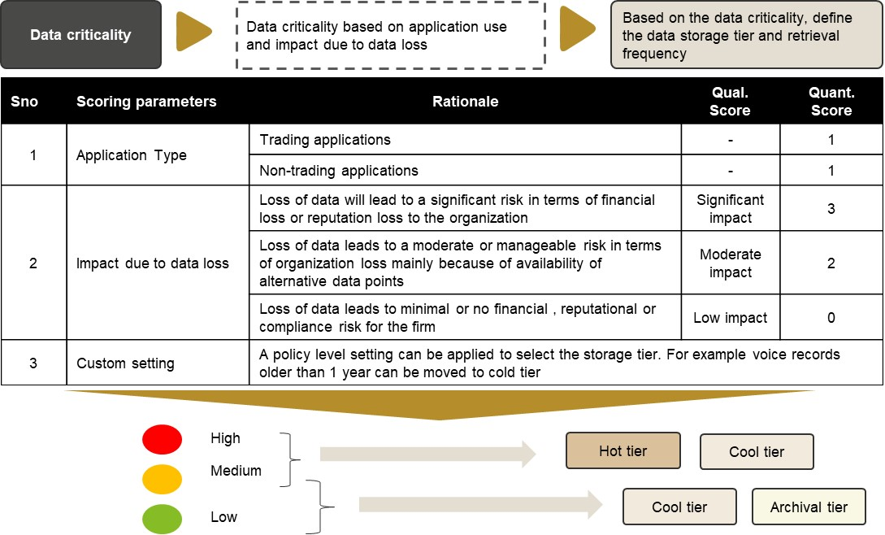
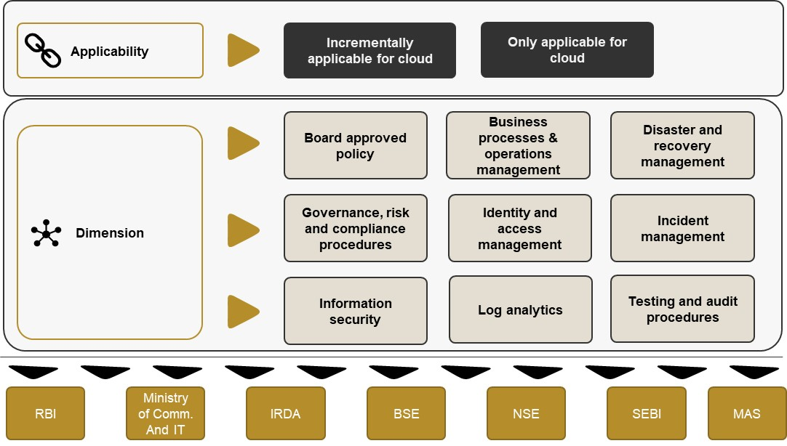
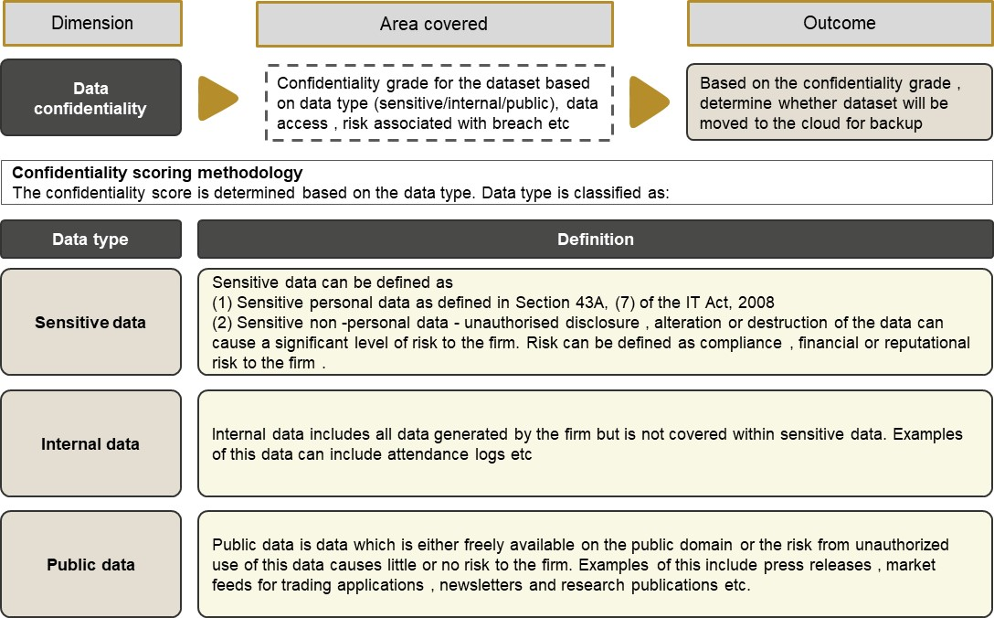
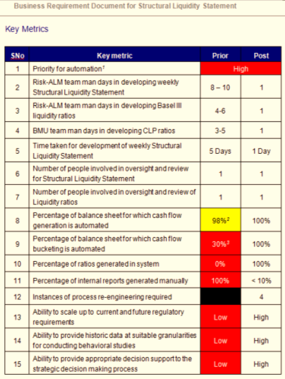
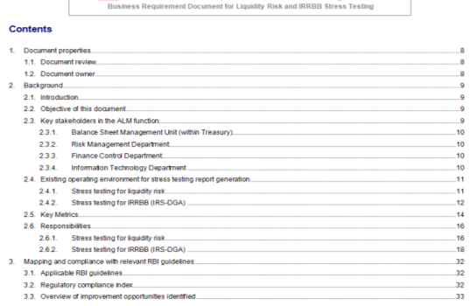
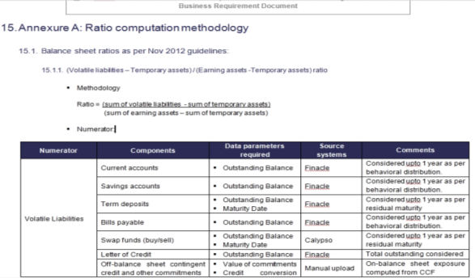
Our detailed approach
II
Requirement finalization
Objective
Assistance in review of business requirements for each department and functional specification document
Key activities to be undertaken
Outcomes from this phase
Conduct workshop to understand department specific requirements including data extraction process, underlying data definitions and user journey.
Review the functional specification document which elaborates the process to deliver objectives outlined in the business requirement document
Review the requirement traceability matrix which maps the business requirements and the approach in which the functionality has been addressed in the functional specification document
Review the designed testing strategy across user acceptance testing and data migration testing
Review the UAT and data migration test case preparation
High-level process maps
Linkages with existing systems and masters to be migrated
Knowledge of lending processes & systems
Awareness of applicable laws and regulations
Extensive experience in functional documentation
Business requirement document
Outcome oriented PMO approach
Differentiators leveraged to expedite project delivery

Slide 21
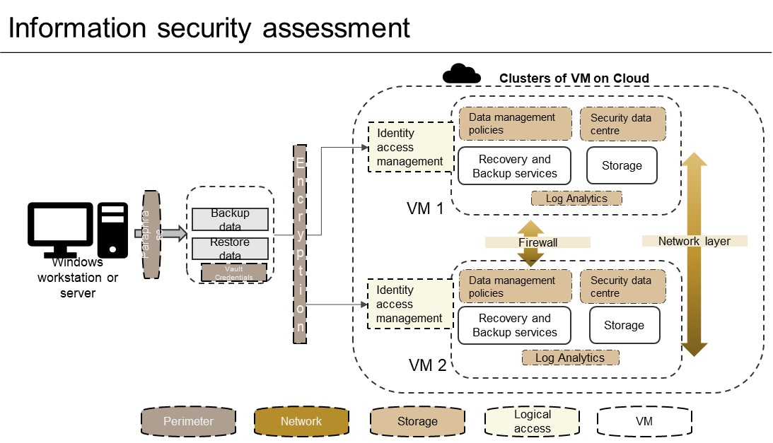
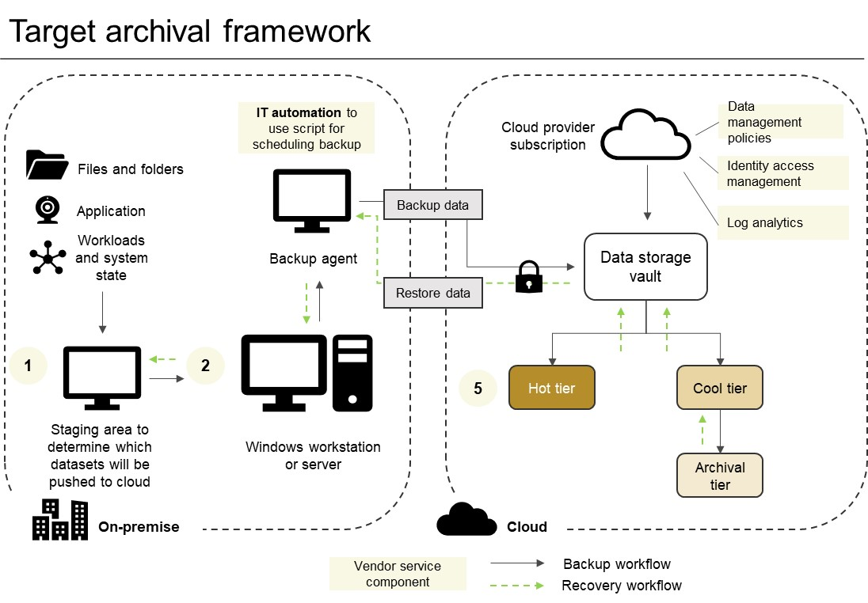
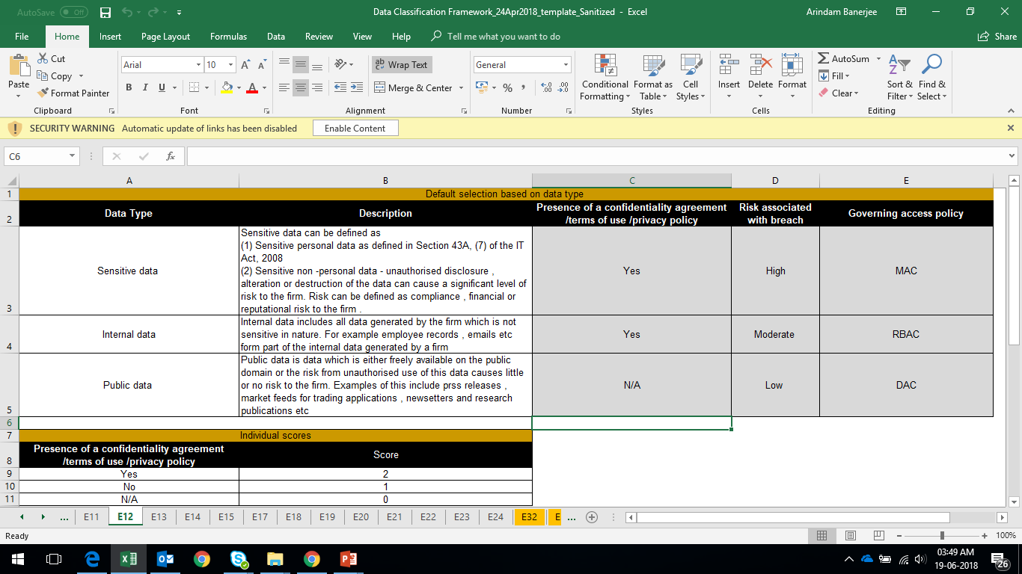
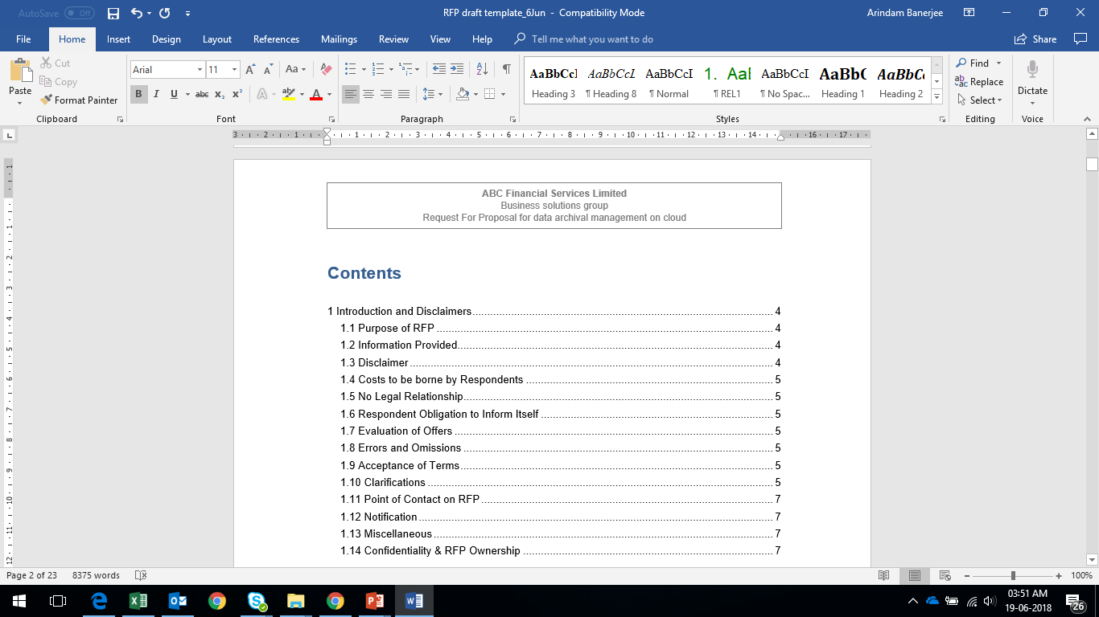
Our detailed approach
III
Data migration strategy and execution design
Objective
Assistance in designing the data migration strategy for the system covering pre-migration strategy and validation framework review, post migration data audit
Key activities to be undertaken
Outcomes from this phase
Define the high-level data architecture with the system and the scope for data migration including the historic data elements that need to be migrated
Define the maintenance strategy for the legacy data which is not to be migrated
Identify the individual data elements that need to be migrated as part of the implementation
Define the data quality and assessment checks that need to be performed to ensure completeness and accuracy in the data migration
Design the underlying test cases based on the data quality checks for undertaking data migration
Scope of data migration and data migration strategy
Data migration test cases and data quality checks
Familiarity with system implementations
Familiarity with data migration projects
Experience of
new-age technologies
Prebuilt repositories of data quality checks
Differentiators leveraged to expedite project delivery

Slide 22

Our detailed approach
IV
System configuration – Functional support
Objective
Functional assistance for clarifications in line with FSD, query resolutions and any workarounds on business requirements
Key activities to be undertaken
Outcomes from this phase
Where required, provide functional understanding to the system vendor for application configurations in line with business requirements.
Review of the business and functional requirement documentation to align change requirements, if any, as identified by the vendor.
Participate in the workaround where required in case current system configurations are unable to meet the business requirements
Review the updated requirement traceability matrix to ensure that the system configurations meet the business requirements documented
Workshops for functional requirement understanding as required
Updation of the requirement traceability matrix
Familiarity with system implementations
Familiarity with functional requirements
Experience of
new-age technologies
Prebuilt repositories of data quality checks
Differentiators leveraged to expedite project delivery

Slide 23
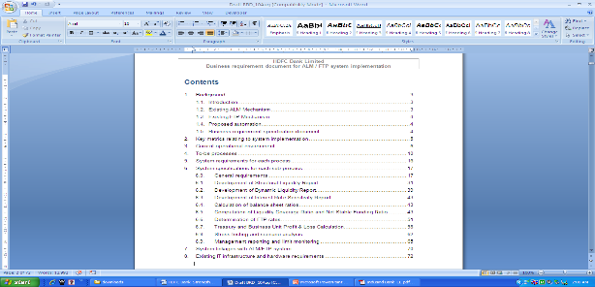
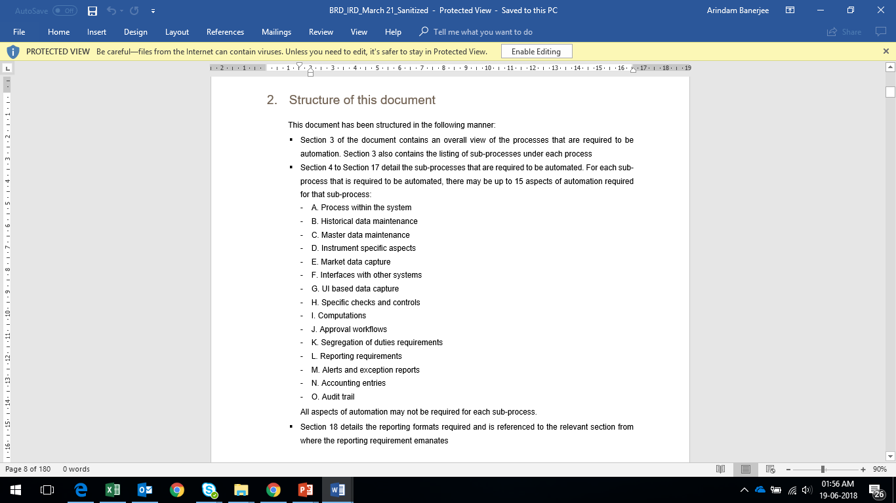
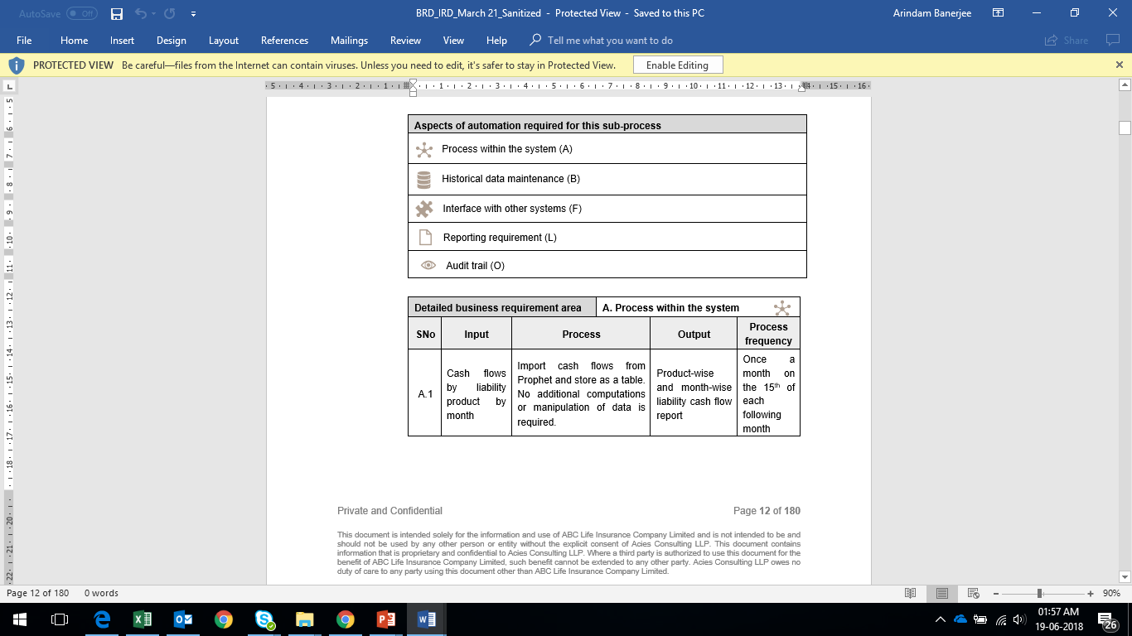
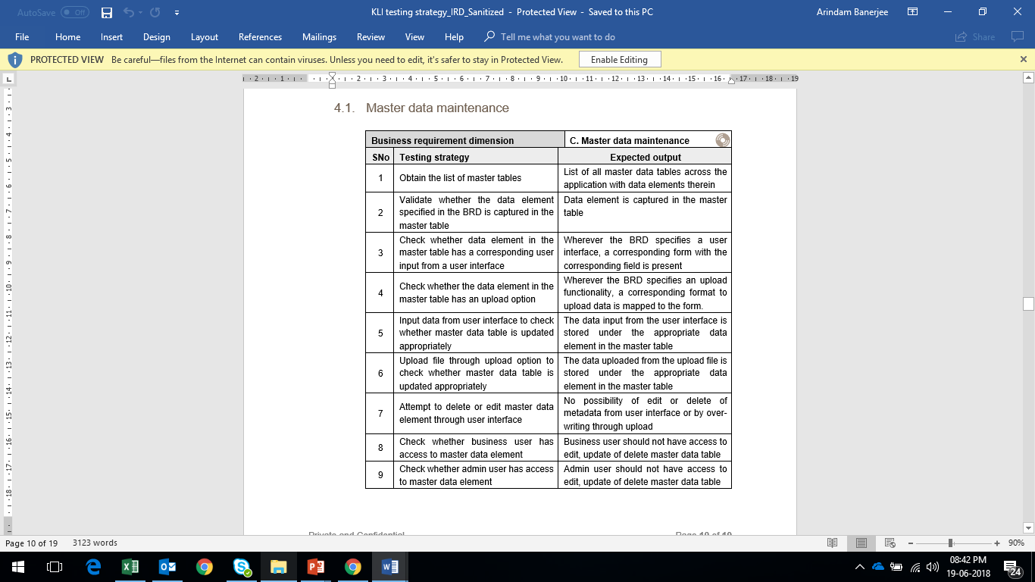
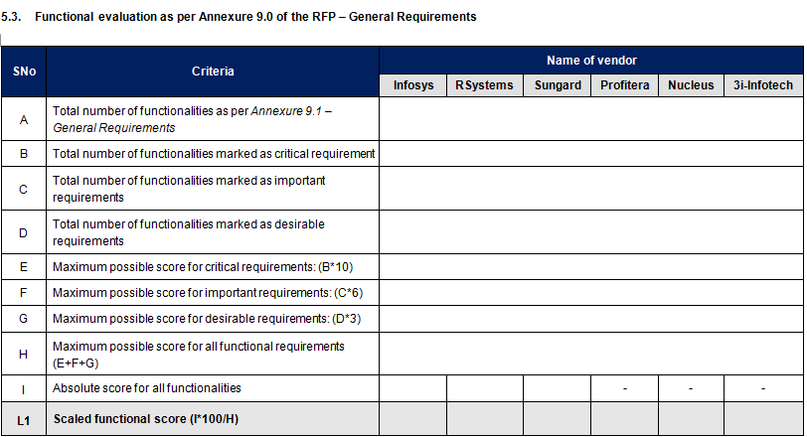
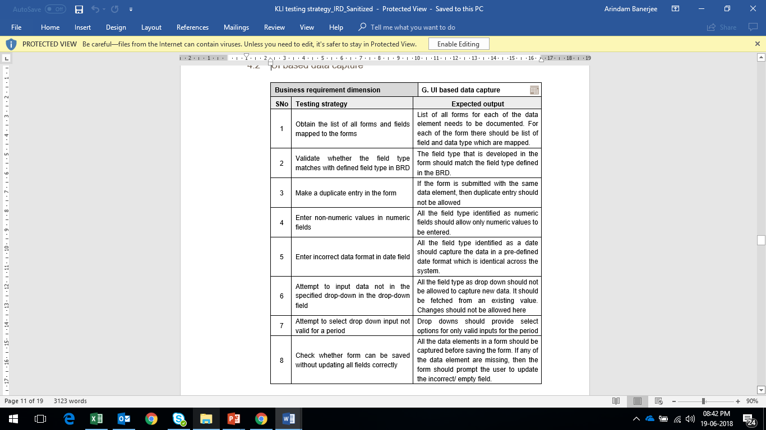
Our detailed approach
V
Testing and validation
Objective
User acceptance testing and data migration testing support
Key activities to be undertaken
Outcomes from this phase
Provide walkthrough of the UAT test cases
Assistance in independent testing of all functionalities
Assistance in validation of system outputs with excel based calculations to validate computation logic developed
Assistance in testing of the business rules configured with the expected output
Test cases to be executed by the respective stakeholders in UAT environment
Assist in documentation of the results of the user acceptance testing
Undertake the data migration testing in line with data migration strategy requirements
UAT test case execution and documentation of results
Retesting and final signoff on UAT
Familiarity with system implementations
Experienced team of UAT testers
Functional understanding
Prebuilt repositories of data quality checks
Differentiators leveraged to expedite project delivery

Slide 24
Success factors for each stage of the implementation
I
Design and setup project governance structure
On-going project management
Project management for ongoing change requirements
Project management
and governance
II
Requirement finalization
Comprehensives of business requirements
Clarity in to-be state processes
Competence building in implementation team
Designing the business performance metrics
Internal and regulatory reporting requirements
Documentation of system configurations
III
Data migration strategy and
execution design
Intelligent data structuring and validation
Comprehensiveness of interfacing with other systems
Quality of data migration
Service desk processes for user support
IV
System configuration – functional support
Comprehensiveness of configuration of pre-built functionalities
Decision on customization on selection system & use of tools outside the system
Capability and capacity for ongoing system enhancement and change requests
V
Testing and validation
Relevant and comprehensive test cases
Test cases ensuring traceability of business requirements
Comprehensiveness of testing
Monitoring of business performance metrics
Comprehensive user training on system and processes

Slide 25
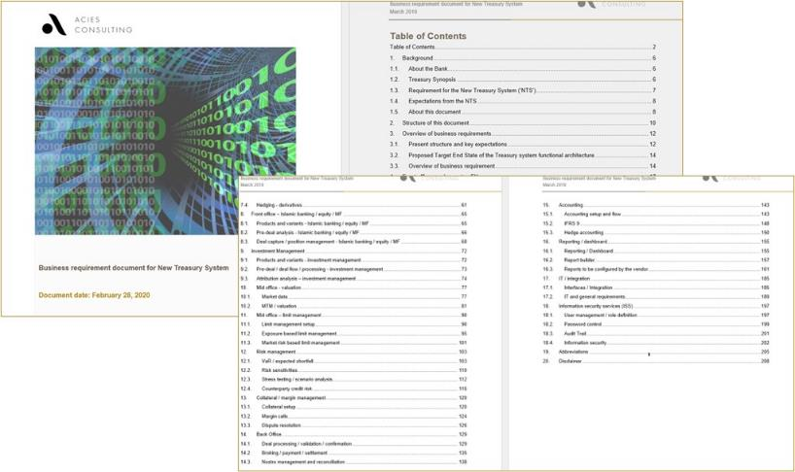
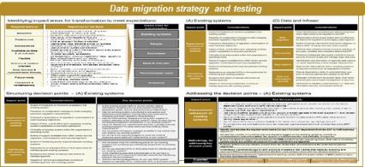
Project accelerators
Repository of pre-existing tools and templates to accelerate desk setup
I
Requirement finalization
Pre-developed BRD documents to enable discussions with business and vendor
Detailed BRD to be used as an accelerator for project kick-start
II
Repository of scenarios, test cases, data and reporting templates
Data migration strategy to cover key considerations and critical success factors for selecting and deploying a flexible data structure
Data migration strategy and
execution design
Our extensive setup and system implementation experience, across multiple platforms / OEMs, has allowed us to create proprietary tools and templates which can be rapidly deployed to expedite project delivery.

Slide 26
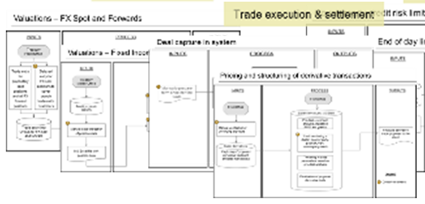
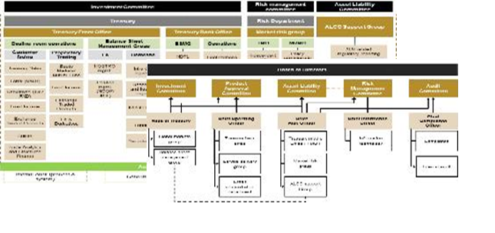
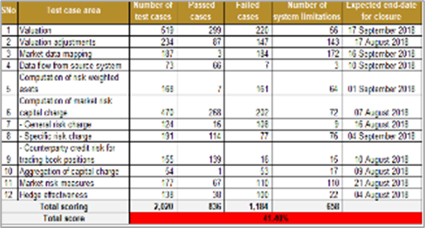
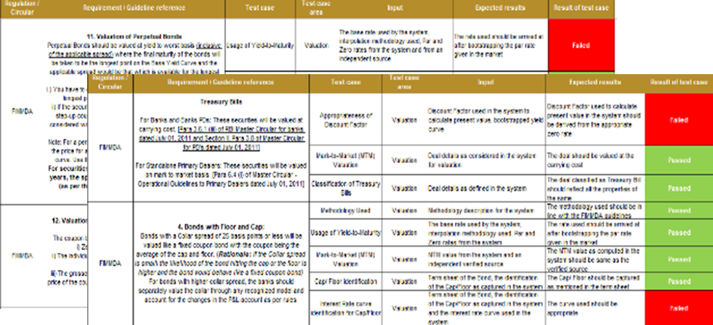
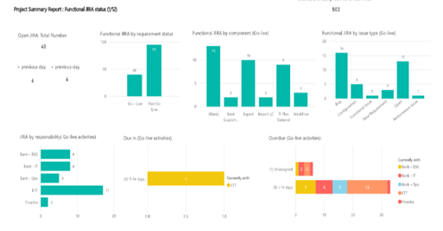
Project accelerators
Repository of pre-existing tools and templates to accelerate desk setup
III
System configuration – functional support
Functional support on different areas
Organization and role-level performance metrics
To-be processes, covering every function undertaken by the business functions as well as operational risk & control assessment
IV
Repository of scenarios, test cases, data and reporting templates
Detailed test cases and scenarios for user acceptance testing
Templates for reporting results of UAT test cases and live UAT dashboards
Testing and validation
Our extensive setup and system implementation experience, across multiple platforms / OEMs, has allowed us to create proprietary tools and templates which can be rapidly deployed to expedite project delivery.

Slide 27
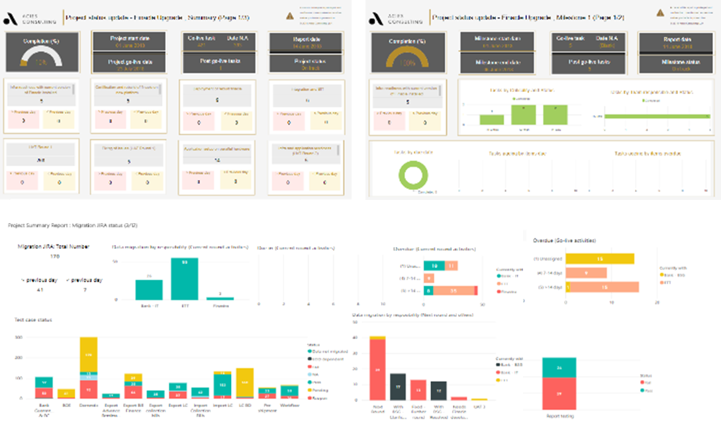
Project accelerators
Repository of pre-existing tools and templates to accelerate desk setup
V
Project management
and governance
Live, real-time update of project status and delays
On-demand, multi-form factor, online access to dashboards
Ability to drill-down across project stages & stakeholders
Our extensive setup and system implementation experience, across multiple platforms / OEMs, has allowed us to create proprietary tools and templates which can be rapidly deployed to expedite project delivery.

Slide 28
Teaming model and governance structure

Slide 29
Teaming model
System OEM
Project sponsorship
Decisions on budgets and procurement
Functional decisions
Project Management Office
Hardware provider
Provide licenses for the system
Provide enhancements and upgrades
Provide hardware on a buy or lease basis
Commit to uptime requirements
Siemens Financial Services Pvt Ltd
Acies Consulting
Performance testing third- party
Scope validation, contracting and setting SLAs
Project management and stakeholder management
Business requirement documentation
Organization structure, policy and procedure design
Data migration
Development of test case
System testing
Process documentation and enhancement
Ongoing testing of system performance
Configuration and implementation of the system
Unit testing
Integration and interfacing with other systems
OEM implementation team

Slide 30
Project team structure
Steering Committee
Acies Project Owner
Viraj Shah
Company Project Sponsor
Company Project Sponsor
Company Project Leader
Company IT Team
Other stakeholders identified by Company
Acies Project Owner & Project Leader
Acies Project Leader
Zeel Shah
Company Project Leader
Project team members
Prabhakar Gujari
Sweety Porwal
Stakeholders from IT Teams
Working Group
Stakeholders from Business Teams
Company Project Leader
Company IT Team
Identified SMEs/ SPOCs of Company
Acies Project Leader & Project Team
SMEs
Sarthak Jambekar
Pritha Dalmia
Stakeholders from other ancillary functions like Finance, Compliance etc.
Select experience of implementation team
Experience with 50+ institutions over the last 10+ years, incl. Indian entities of global financial institutions
Kotak Mahindra Bank
Axis Bank
SBM Bank India
Gulf Bank of Kuwait
DBS Singapore
VW Financial Services
Toyota FS
Edelweiss FS
Axis Finance
Capri Global
Vedanta Resources
Nayara energy
NPCI
SAMA
2 Life insurers

Slide 31

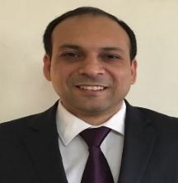
Professional profiles
Muzammil Patel
Managing Director
Muzammil Patel has more than 12 years professional experience in the consulting industry. In his most recent role, he was a Partner and Leader of the Financial Services Risk Advisory practice for one of the largest Consulting Firms in India. He was also the Leader for Risk Advisory Innovation and Treasury Advisory.
During his career, Muzammil has worked closely with more than 100 organizations across geographies helping them re-define their Treasury & risk management strategy, regulatory transformation journeys and technology transformation. He has led engagements for selecting / implementing Treasury and risk management systems across multiple OEMs including Calypso, Murex, FIS, SAS, OFSAA etc.
Abhinava Bajpai
Managing Director
Abhinava Bajpai has more than 14 years professional experience in the consulting industry. In his most recent role, he was a Partner with one the largest consulting firms in India. In his role, he was responsible for administration of the Financial Risk Management practice.
During his career, Abhinava has worked closely on Treasury and market risk system implementation engagements with leading financial institutions across 10 countries. He has assisted multiple financial institutions in validating their Treasury and risk measurement models including those for MTM valuations, VaR, Greeks, SMM / IMA capital computation and stress testing.

Slide 32
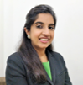

Professional profiles
Viraj Shah
Executive Director
Viraj is an Executive Director with Acies and has more than 12 years of experience in financial services and consulting space. In her current role she heads Business Solutions which specializes in digital transformation, automation and no code technology implementations. She also supports the development team in architecting the platform features to serve intelligent automation requirements on Revolutio.
She has worked closely with banks and institutions globally on a range of advisory and implementation initiatives including technology architecture design and fitment, business and technology transformation, risk management and operating model enhancements.
Zeel Shah
Senior Consultant
Zeel has experience in assisting clients with their automation requirements, having worked on bespoke developments and conducting system feasibility studies for financial institutions. She has also worked extensively on business process automation using cloud-based business technology frameworks such as Microsoft PowerApps, PowerBI, Microsoft Flow and associated technologies.
She has assisted a leading bank in creating data management frameworks for regulatory reporting and automation of the same. She has also managed and run the project management office for leading bank overseeing their system upgrade project.

Slide 33


Professional profiles
Prabhakar Gujari
Prabhakar currently works as part of the Business Solutions team at Acies and has extensive experience in working in financial services and consulting. In his current role, he works on projects pertaining to data management, automated analytics and business process automation. He has extensive experience on defining business requirements and functional specification documents, configuring automation on no-code application technologies and data transformation for creation of automated reports and dashboards using business intelligence tools and data management technologies such as MS Power BI, Python and SQL
Sweety Porwal
Sweety is currently working as part of the Business Solutions Team with Acies and has rich experience across the financial services and consulting domain. Prior to joining Acies, she has worked with leading investment banks in financial operations. As part of her current role, she discusses and understands client requirements, manages workflows and resources on time sensitive projects. She actively works on automation of MIS of a leading bank through Power BI as a reporting tool. She has extensive experience on configuring automation on no-code application technologies and data transformation for creation of automated reports and dashboards using business intelligence tools and data management technologies such as MS Power BI, Python and SQL

Slide 34

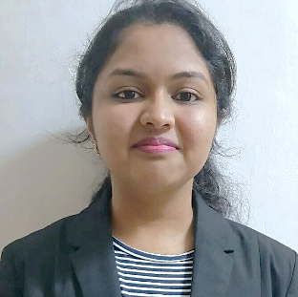
Professional profiles
Sarthak Jambekar
Senior Consultant
Sarthak is an ACCA with 4 years of experience in the consulting and advisory space. In his most recent role, he was working with one of the largest consulting firms in India as a senior consultant and was responsible for IGAAP financial statement conversion to IFRS, was also involved in implementation of loan origination system for an Australian lending company.
During his career, he has also been involved in ECL and EIR computations for various Indian and Australian banks and NBFCs. He has been involved in system implementation for IFRS 9 application for various NBFCs and banks. He has also been involved in system implementation of OFSAA LLFP module.
Pritha Dalmia has rich professional experience in the consulting and system implementation space. She has led and conducted complete end to end IFRS 9 system implementations in India, Middle East and Asia Pacific Regions. She has also worked on various credit risk models (PD, LGD, ECL and rating models) across the 3 geographies. She has assisted in implementing/ reviewing the ICAAP framework across banks and NBFCs in India. Her core competencies include system design, data management, regulatory reporting, system implementation and credit risk modelling.
She is a partly qualified Actuary and holds a bachelor’s degree in Accounting and Finance (BAF). She is proficient in various programming languages like Python, R and SQL.
Pritha Dalmia
Senior Consultant

Slide 35
Select case studies and credentials

Slide 36
Data migration – a critical success factor for system implementation
Third party systems
Data mgmt. and migration
Experience of new age technologies
Real-time project management
Experience across implementation lifecycle
Inputs necessary for the system implementation
High level data architecture with the LOS, LMS system
Scope of data migration for implementation partner
Factors driving the data migration strategy for LOS, LMS system
Identification of data elements for migration
Decision on migration of historic data
Data quality assessment and enrichment needs
Maintenance strategy for legacy data not migrated
Data archival strategy for the
system
Scope for leveraging new- age technologies
Extensive experience of data architecture, migration strategy and testing
Data architecture development and migration assistance for ERP implementation
Establishing data mart for IFRS 9, ALM and generation of regulatory reports related to the same
Development of data architecture, data mart for regulatory and compliance reporting
Mapping of data elements, data quality assessment, data management to meet BI reporting requirements
A payment utility
Leading NBFCs
A leading NBFC
A leading Bank
Experience referenced includes Acies’ own experience as well as the experience of professionals with their previous organizations

Slide 37
Hands-on experience of new-age technologies
Third party systems
Data mgmt. and migration
Experience of new age technologies
Real-time project management
Experience across implementation lifecycle
Our demonstrated ability to successfully leverage new-age technologies & microservices such as on-demand analytics, cognitive intelligence and cloud allows us to identify specific points in the system architecture where such technologies may be deployed.
Select engagement experience
Customer onboarding automation using no-code tech for leading private sector bank
Cloud management services for multiple life insurers, banks, NBFCs, SFBs
Cloud based data archival for a leading financial conglomerate
Development of applications for customer suitability assessment, onboarding and management leveraging no-code technology
Development of dashboards & performance metrics for mgmt.
Selection of cloud data storage provider and specifying the technical requirements
Managing cloud instance on an on-going basis and optimization of the cloud services
Data archival strategy identifying data elements, retention period, end-use & criticality assessment
Selection of cloud data storage provider, on-going support of the implementation & system UAT
Benefits derived by the Clients
Reduced implementation time and effort where off-the-shelf microservices can be leveraged
Potential reduction in system TCO due to
cost-effective nature of on-demand microservices

Slide 38
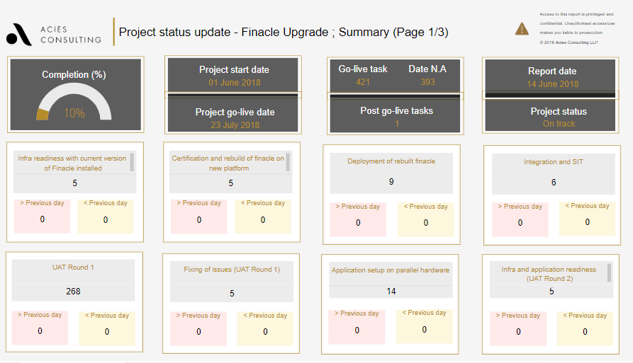
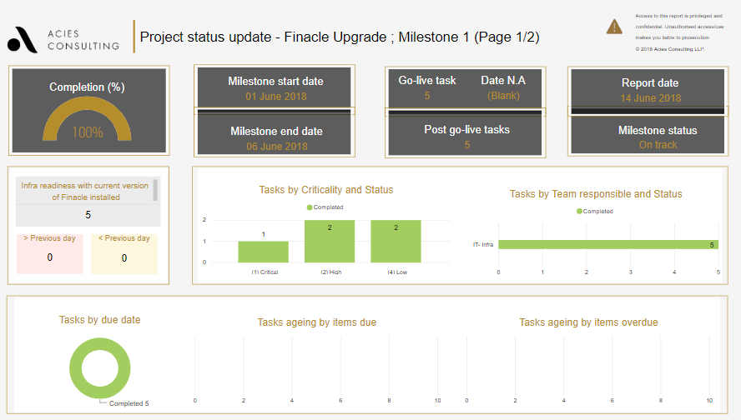
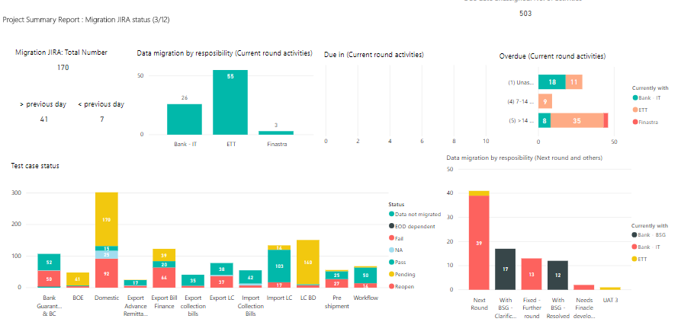
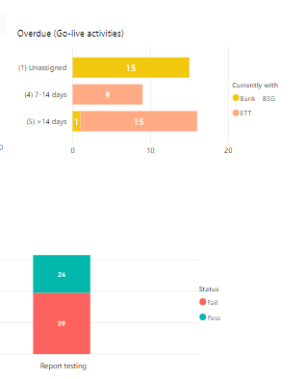
Real-time project management through live, online dashboards
Third party systems
Data mgmt. and migration
Experience of new age technologies
Real-time project management
Experience across implementation lifecycle
In order to provide a transparent project management platform, we leverage the capabilities of Microsoft Power BI which allows project progress to be tracked and monitored on a near real-time basis.
Live, real-time update of
project status and delays
On-demand, multi-form factor,
online access to dashboards
Ability to drill-down across
project stages & stakeholders

Slide 39
Experience across all stages of the implementation lifecycle
Third party systems
Data mgmt. and migration
Experience of new age technologies
Real-time project management
Experience across implementation lifecycle
Select experience in system selection/ implementation
Requirement specification
RFP creation and issuance
Vendor selection
Data migration and testing
Model review and validation
System config. and / or testing
Volkswagen Finance
Edelweiss FS
SBM Bank, India
Kotak Mahindra Bank
Vedanta
NPCI
AU Small Finance Bank
Gulf Bank of Kuwait
Edelweiss FS
Toyota Financial Services
Capri Global
Axis Finance
Utkarsh SFB
SBM Bank, India
NPCI
AU Small Finance Bank
Gulf Bank of Kuwait
Edelweiss FS
Volkswagen Finance
NPCI
Gulf Bank of Kuwait
MTC / Zain
Omantel
SBM Bank, India
Volkswagen Finance
Toyota Financial Services
MTC / Zain
Omantel
Our system selection and implementation experience spans multiple financial institutions across geographies. The range and depth of our experience allows us to leverage pre-existing tools & enablers for expedited project delivery and deliver value to clients.

Slide 40
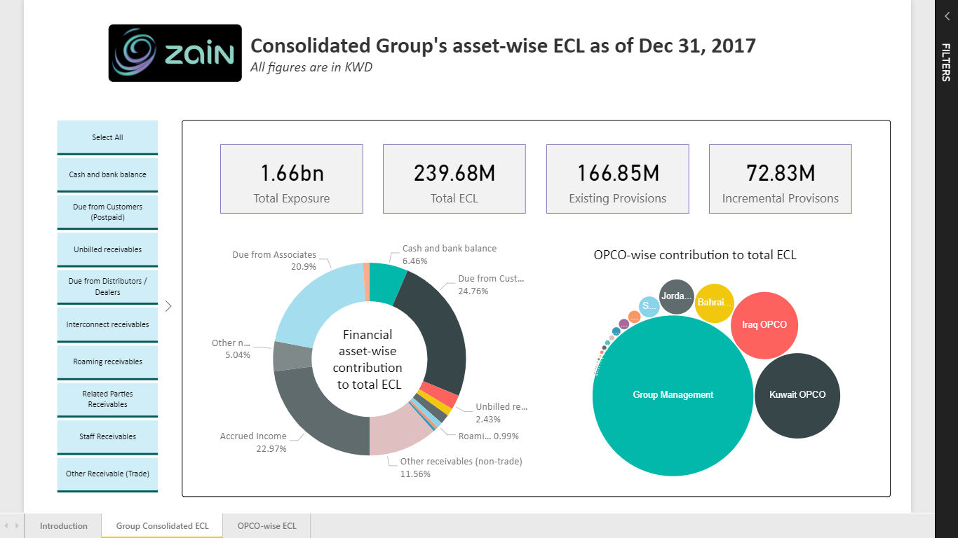
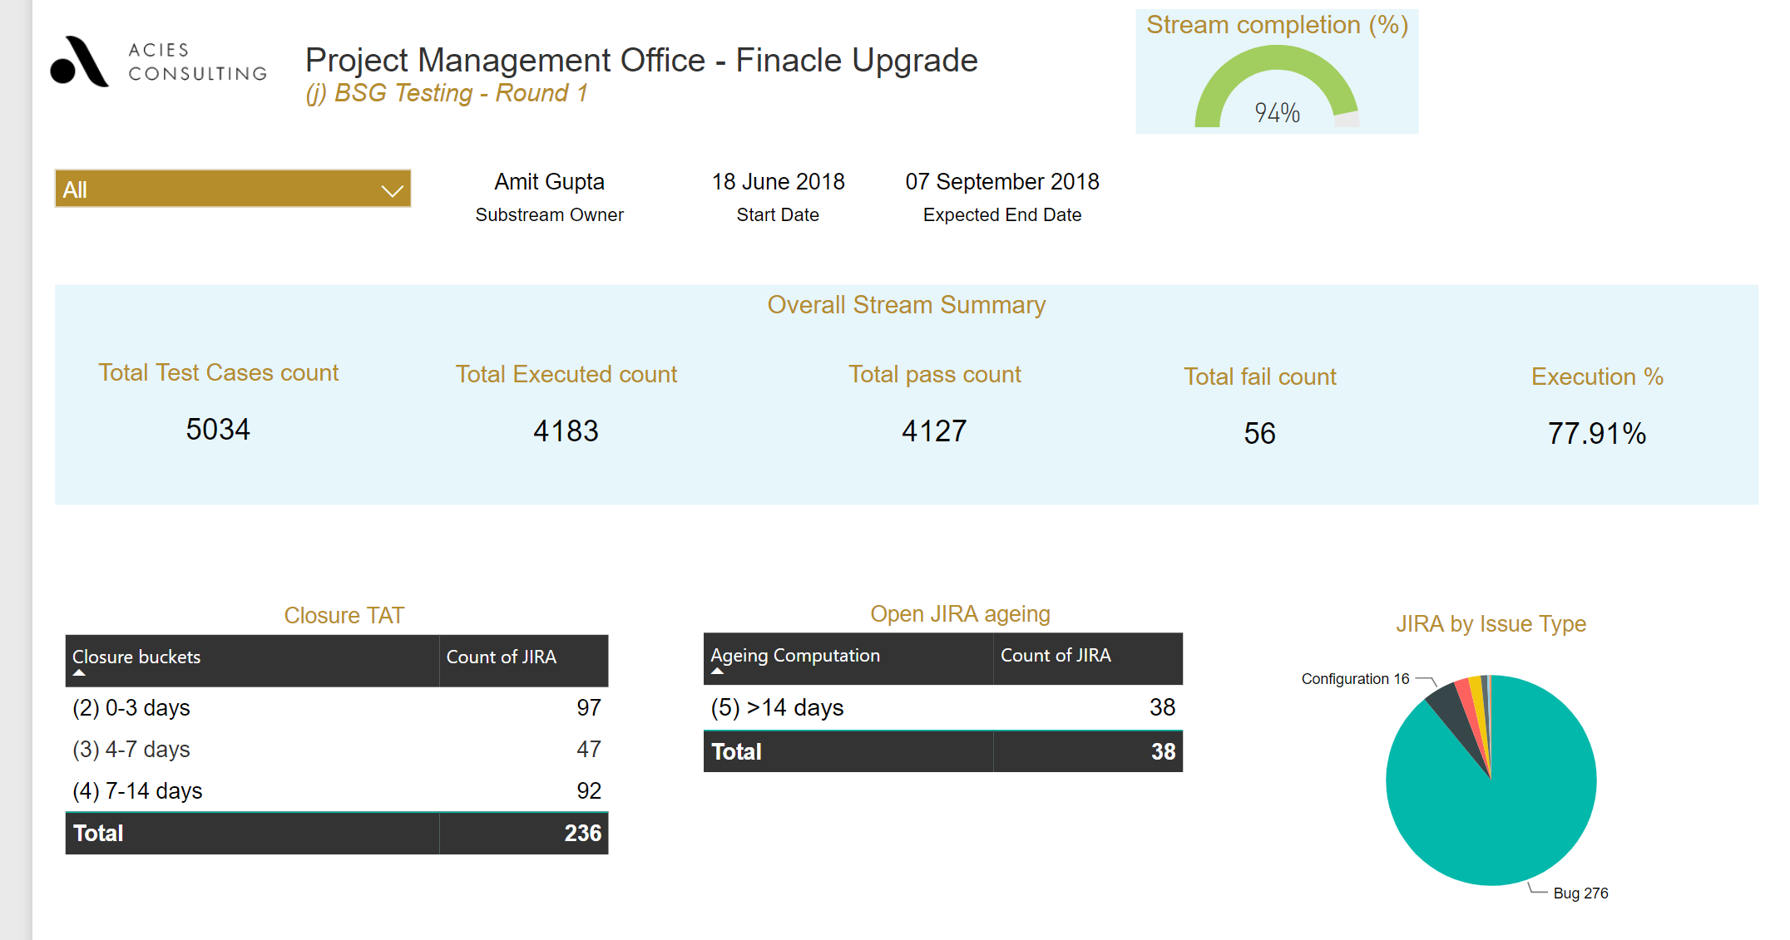
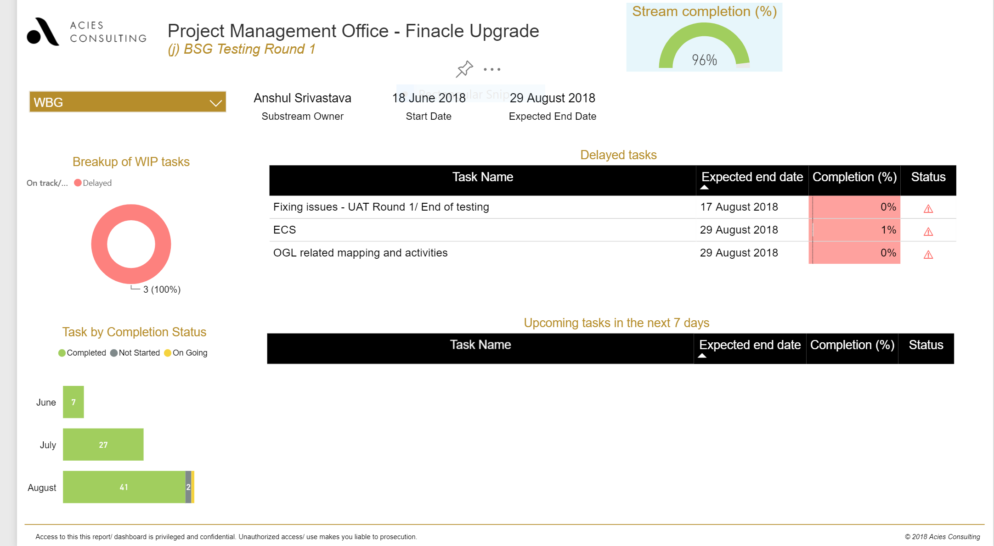
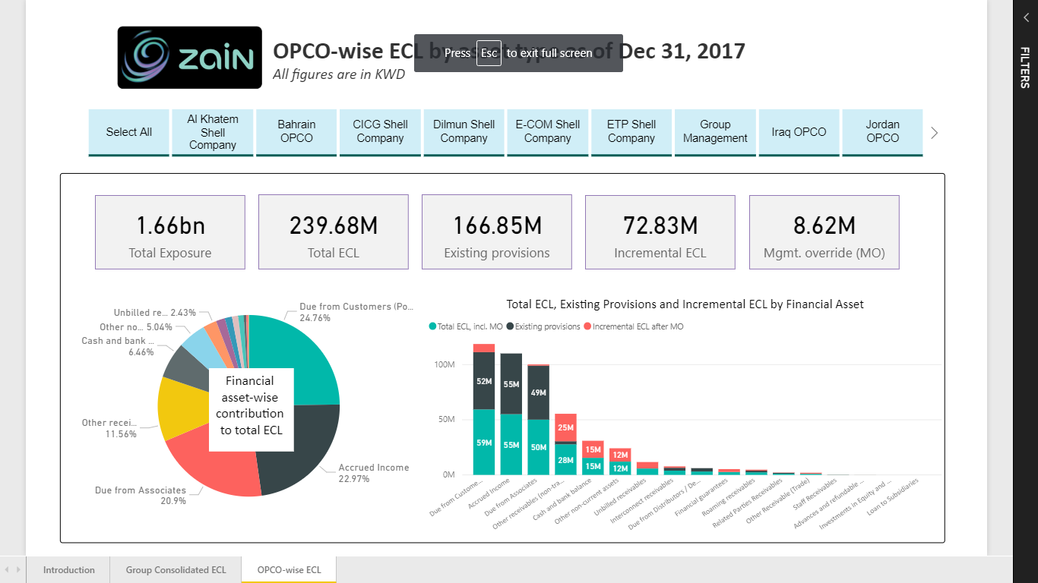
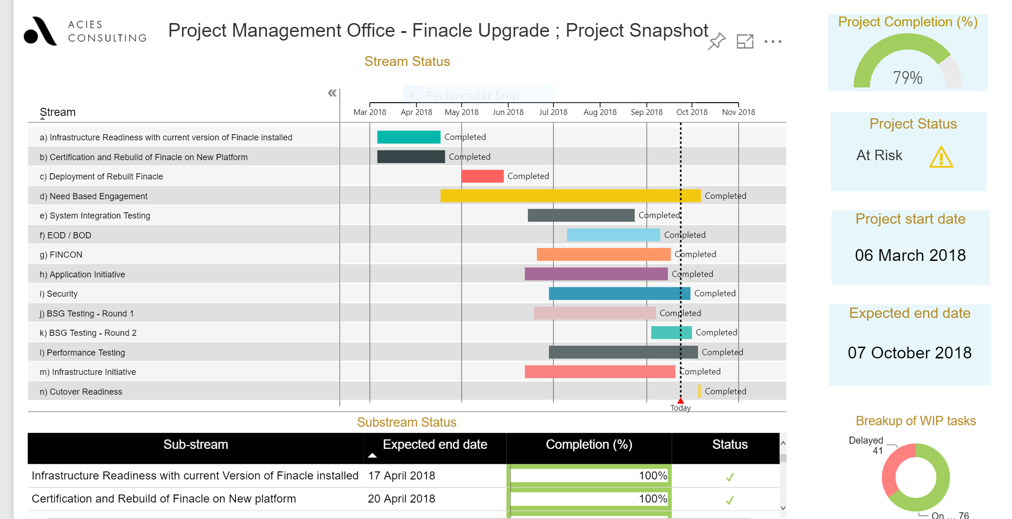
Select case study- Project management for transformation projects
Technology enabled near-live project tracking and project risk management for multiple Banks and other financial institutions
Use of in-house developed tool for project tracking and project metrics monitoring
Ability to identify and define responsibilities at a granular level
Automated alert generation for pending and scheduled activities
Creation and tracking of project plan with early warning indicators
Stakeholder communication and escalation management
Early identification of pre-requisites and dependencies to avoid road blocks
Project cost management.
Identification and mitigation of project risk
Use of in-house developed technology platform
PMO dashboards and stakeholder briefs
Live project tracking
Application of our project management methodology successfully at multiple clients
A leading financial conglomerate
A leading private sector bank
A leading non banking finance company
A leading private sector bank
Implementation of the Loan Management system
Upgradation of the core banking application (Finacle)
Accounting function transformation and financial statement closure
Implementation of trade finance system (TI Plus)

Slide 41
Select case study – Functional assistance and project management
As part of setting up of new treasury system, the bank sought assistance for setting up the derivative desk along with providing the functional assistance requirement during system implementation
Overview of Engagement Work-Streams
Bilateral netting framework
UAT and Go-Live
Project management and ad-hoc functional support
III
IV
Functional framework and set up
II
I
Understand the expectations from the system and development of BRD, preparation of product notes, policies and SOPs
Provide on-going updates to senior management and provide functional support and inputs across the project
Identification of existing netting sets of counterparties and preparation of netting models
Undertaking testing, providing UAT assistance and go-live preparation
Scope and key aspects covered during the engagement
Key Challenges
Preparation and issuance of BRD and validation of scope with vendor
Preparation, issuance and training on policies
Preparation issuance and training on SOPs
Preparation and issuance of product notes
Spreadsheet models for computations and documentation of methodologies
UAT, model validation and go-live
Key Outcomes
Finalized business requirements and stakeholder sign-off
Functional assistance and support banks team to drive the project
Detailed documentation of relevant policies for setting up a treasury desk
UAT testing strategy document and library of test cases

Slide 42

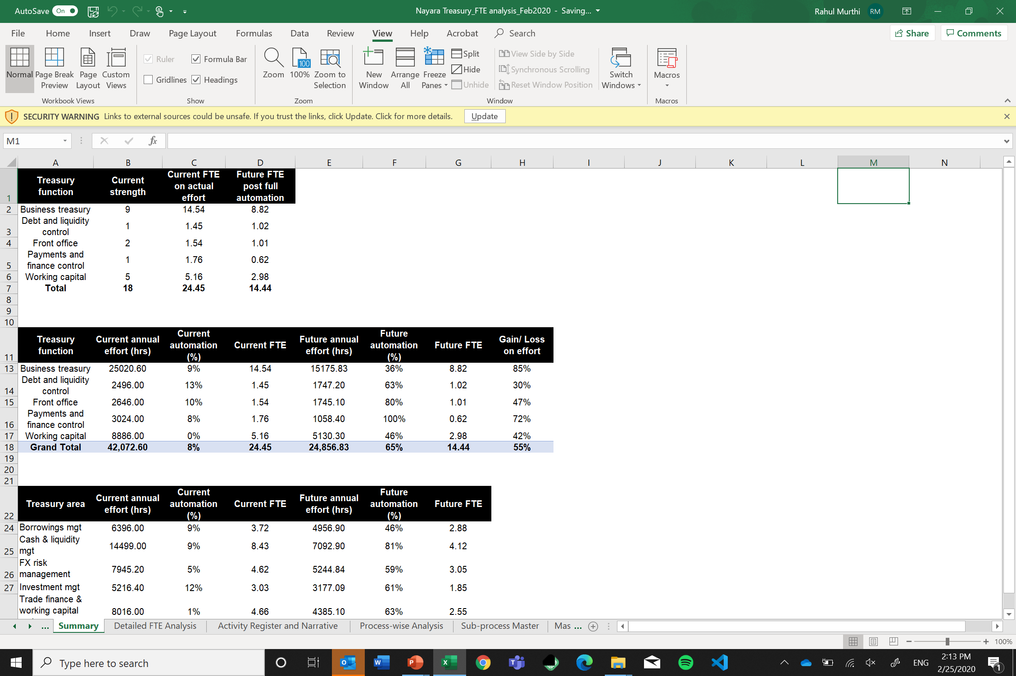
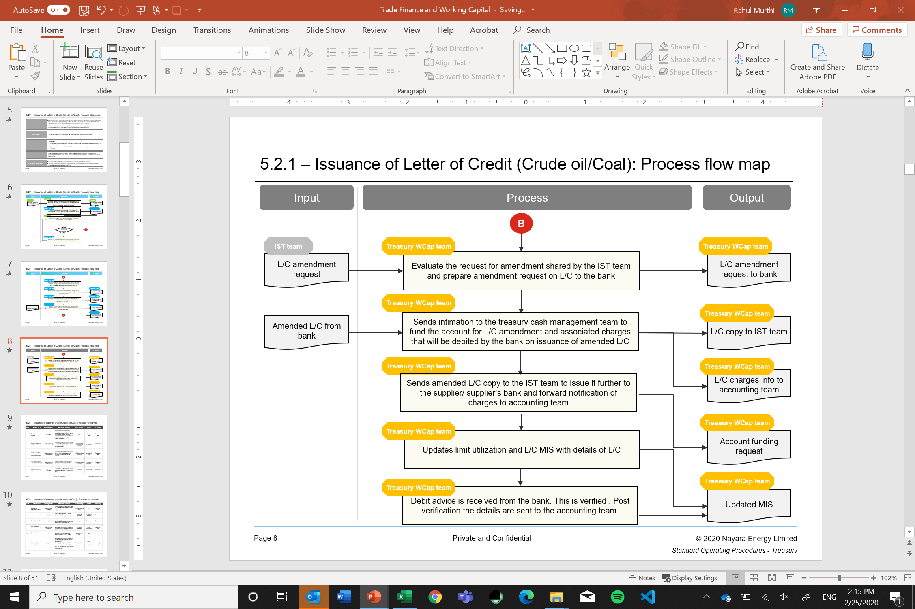
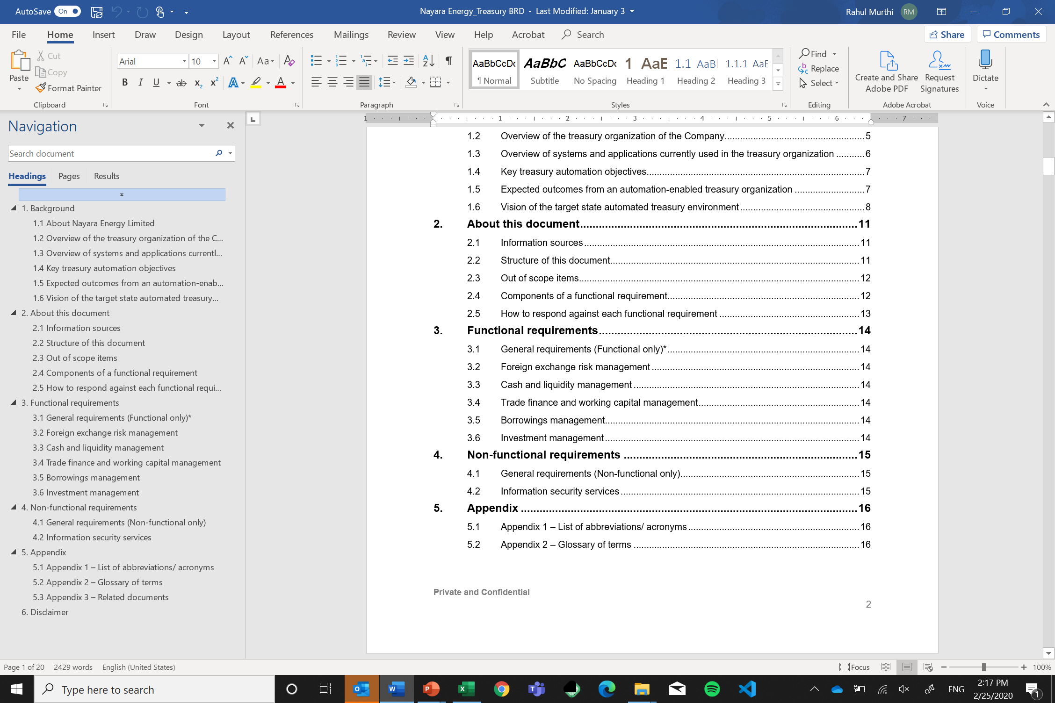
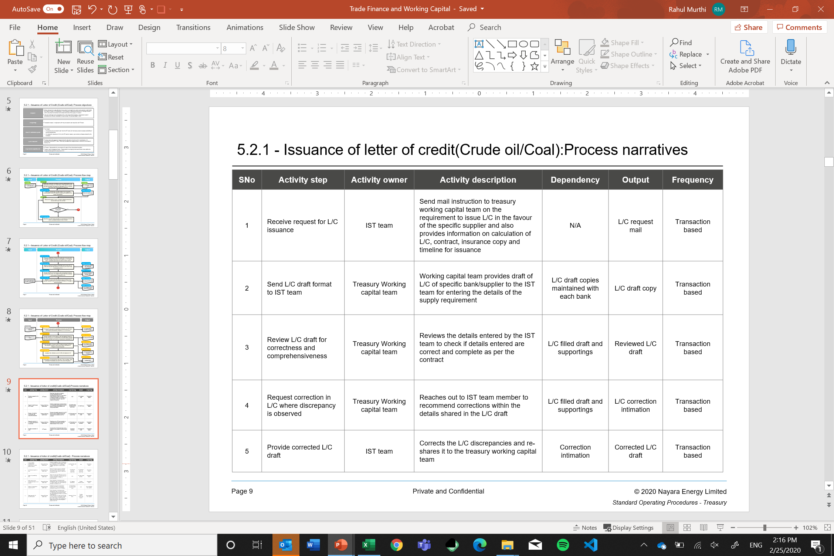
Select case study – Project management and automation support
Treasury processes covered
> 35 processes
Documentation of improvement in treasury processes and controls
Post automation FTE reduction opportunity
> 30%
100% coverage of updated documented treasury and accounting process flows
Tangible benefits
Reduction in cost of manpower and operations post automation
Corporate treasury expertise
A large oil refiner in India
Treasury transformation know-how
Treasury automation expertise
Implementation experience
> 60% of manual processes that can be automated
Tangible benefits
Future-proof treasury management system selected – under implementation
Functional requirements identified
> 200 across all treasury areas
Hand-holding assistance throughout the automation process
Systems evaluated for implementation
> 3
Copyright © 2018 Acies Consulting LLP

Slide 43
Project management and technical support on Calypso Implementation for a Central Bank in ME
Select case study - Program management for system implementation
Project highlights
Client Objectives
Key outcomes
Very large project involving implementation of Core, ERP and Treasury platforms.
Involvement of 4 different service providers and many independent professionals
Many non-standard functionalities due to nature of the client
Project was running very late with many missing deadlines
Huge cost variations than budget
Reliability on the progress of the project implementation
Project monitoring, cost analysis and cost control
Resource management and provide technical resolutions
Timely deliveries with quality solution.
Coordination with multiple stakeholders
Meeting project timelines
1
Comprehensive project plan with responsibility allocation and interdependencies
2
Troubleshooting with timely resolution of roadblocks by applying domain expertise
3
Increased predictability of cost budgets with minimal deviations
Critical success factors for the engagement
A combination of project management specialist and technical expert to manage and steer the project to successful completion.
4
Stakeholder management by establishing effective communication channels and project governance
Experience in working on large scale technology transformation project involving multi-disciplinary project members
Combination of appropriate skill sets required to manage such a large and complex project.

Slide 44

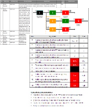





Select case study - Technology architecture and enhancement
Re-engineering processes
India’s largest payment utility
Future proof ERP
system selection
Re-engineered treasury, procurement, administration, finance, human resources and customer relationship management processes
Technology architecting and feasibility
Chart of accounts hierarchy and dimensionalization
Evaluation of SAP, Microsoft Dynamics, Infor, Oracle Financial, TCS Bancs and Ramco
Finance and Treasury
27 processes
On-prem and cloud ready
6 ERPs evaluated
Tangible benefits
Reduction in process TAT and improved SLAs with product teams ~ 20%
More than 75% of Finance processes automation ready
Decision support and analysis ready data structures
Experts on finance processes in FSI
Emerging technology knowledge
Data management experience

Slide 45





Select case study - Finance process re-engineering and operation
Finance and accounts processes
>85
processes
Finance org operating model review
Process documentations
Automation identification
Finance process automation opportunities
~10x from
current state
> 90% of documented finance processes and controls
More than 60% of finance processes identified for immediate automation
Tangible benefits
FSI finance process experts
A leading auto-finance company
Process transformation know-how
Accounting expertise
Regulatory and data mgt expertise
Minimal disruptions in financial closure activities on account of staff changes
Tangible benefits
Accuracy and traceability of source information applied in regulatory filings
Quarterly closure and reporting support
IndAS and
IFRS
Handholding assistance for financial closure activities
Pre-regulatory filing data validation
Finance and accounts regulatory reports validated
> 5

Slide 46










Select case study - Digital transformation
Reduction in automation cost by ~ 30%
Tangible benefits
Cut down time to market by 3 months
A leading private sector bank in India
Speedy automation
Regulatory compliance
Process streamlining
Automation in 4 weeks
RBI and DFSA
Policies and SOPs
FSI expertise
Customer onboarding
KYC and Re-KYC
Client suitability and scoring
Account maintenance
Compliance with regulations in India and UAE
Assistance in DFSA permission to commence banking operations
Finance and treasury
Account management
Loan life cycle management
Emerging technologies
Regulatory expertise
Customer onboarding and management
Customer suitability assessment

Slide 47
Select case study – Our SaaS and cloud experience
Managed SaaS deployment of two proprietary applications and deployed on cloud being used by the Client :
Wealth Management monitoring
Derivative life-cycle booking and hedge accounting application
Rationale for adoption
Benefits being derived
Available through annual subscription vs traditional models
Functional and technical expertise being managed
Time to market derivative products and focus on KRI monitoring on wealth management business
Deployment to UAT in less than 15 days
Continuous upgrades without affecting business, timelines or functionalities
Flexibility of usages, consumption and access
Reduced maintenance and support costs
Architecting large scale SAP deployment on cloud
Deployment of cloud and installation of SAP
Ongoing management of cloud services and SAP
Acies assisted architecting the infrastructure, network and security on Cloud along with implementation and deployment of these services.
Installation of SAP and its management on Microsoft Azure under the Managed services (SaaS model)
Assist in analyzing services necessary for deployment of SAP on cloud
Provide know-how of the SAP requisites in order to architect on the cloud
Develop the network architecture and deployment diagram for SAP services
Assist in sizing and if required do a POC of the architecture
Agree on the network architecture and deployment architecture
Deployment of the network services and hardware on the cloud
Assist in hardening of the network and OS in line with Client’s policies
Install SAP on DEV, QA, Prod and DR
Ongoing monitoring of the security and performance of the hardware
Resolve any identified issue and assist in ongoing firewall and networks setup
Ongoing update and patching of the OS and its related components

